Slide 1
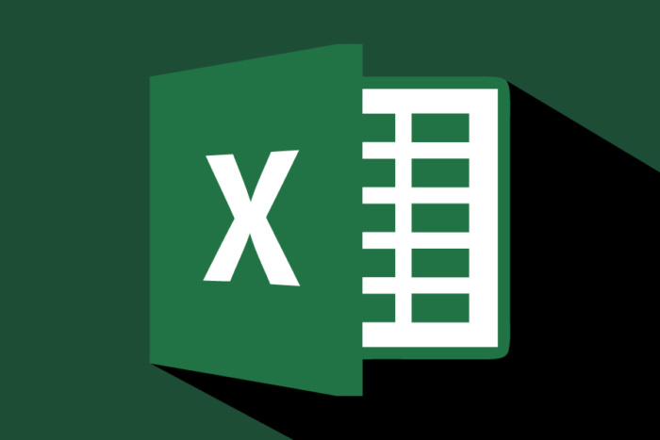
MS EXCEL

Slide 2
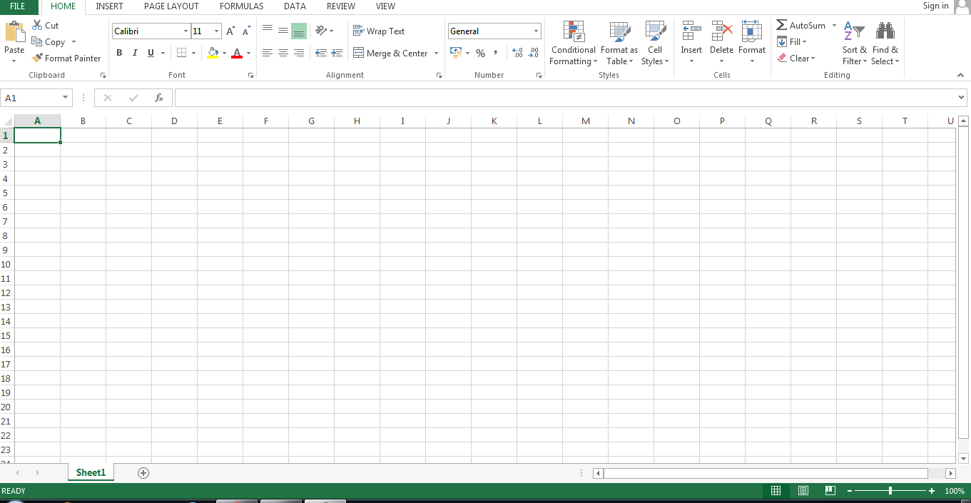
What is MS Excel?
MS Excel is a spreadsheet program where one can
record data in the form of tables. It is easy to analyze
data in an Excel spreadsheet. The image given below
represents how an Excel spreadsheet looks like:

Slide 3
Features of MS Excel
Various editing and formatting can be done on an Excel spreadsheet. Discussed below are the various features of MS Excel.
Home
  Comprises options like font size, font styles, font color, background color, alignment, formatting options and styles, insertion and deletion of cells and editing options
Insert
  Comprises options like table format and style, inserting images and figures, adding graphs, charts and spark lines, header and footer option, equation and symbols
Page Layout
  Themes, orientation and page setup options are available under the page layout option
Formulas
  Since tables with a large amount of data can be created in MS excel, under this feature, you can add formulas to your table and get quicker solutions
Data
  Adding external data (from the web), filtering options and data tools are available under this category

Slide 4
Benefits of Using MS Excel
MS Excel is widely used for various purposes because the data is easy to save, and information can be added and removed without any discomfort and less hard work.
Given below are a few important benefits of using MS Excel:
Easy To Store Data: Since there is no limit to the amount of information that can be saved in a spreadsheet, MS Excel is widely used to save data or to analyse data. Filtering information in Excel is easy and convenient.
Easy To Recover Data: If the information is written on a piece of paper, finding it may take longer, however, this is not the case with excel spreadsheets. Finding and recovering data is easy.
Application of Mathematical Formulas: Doing calculations has become easier and less time-taking with the formulas option in MS excel
More Secure: These spreadsheets can be password secured in a laptop or personal computer and the probability of losing them is way lesser in comparison to data written in registers or piece of paper.
Data at One Place: Earlier, data was to be kept in different files and registers when the paperwork was done. Now, this has become convenient as more than one worksheet can be added in a single MS Excel file.

Slide 5


